Slide 1


Sales Effect Cloud Sweets General Dollar Interim Report
August 2025

Slide 2

Sales Lift Research Overview
Objective
Evaluate the effectiveness and sales impact of the Cloud Sweets campaign at General Dollar.
Campaign
Campaign period:
July 01, 2025 - August 16, 2025
Measurement period:
July 01, 2025 - August 16, 2025
Digital media
Impressions:
9,756,428
6,289,529
Reach:
Frequency:
1.6
Methodology
The study was conducted using test vs matched control methodology. Test group (exposed to this campaign) and control group (not exposed to this campaign) were carefully matched and balanced using pre-period buying behavior and demographics (age, gender, HHI, geo).
Sales Effects metrics: receipt panel (23M monthly active)

Slide 3

Sales Lift Results

Slide 4

Results Summary
Sales Effects
Audience Metrics
9.8M
Up to this point, the Cloud Sweet campaign made a notable impact on the measured products sales at General Dollar, delivering a 6.74% lift in Average Sales per Household.
The sales lift can be accredited to a 3.92% boost in Household Penetration and a 3.04% increase in Purchase Occasions.
Impressions
+6.74%
+3.92%
1.6
1.0x Norms
1.1x Norms
Average Sales
per Household
Exposed vs. Control
Household Penetration
Frequency
Average impressions per household
Exposed vs. Control
6.3M
Reach
Households
###,###
$ ###,###
Attributable Purchase
Purchases after exposure
Incremental Purchase
Purchases after exposure
Source: ABCS Insights Panel

Slide 5
Sales Effect Summary
Sales Lift
Cloud Sweets Sales Effect N=321,184 | Test | Control | Diff | Diff % | Food Norms
Average Sales per Household | $0.07 | $0.07 | $0.00 | 6.74%* | 6.55%
*99% stat sig
Drivers of Sales Lift
Exposed households saw an increase of 6.74% in Average Sales per Household.
This lift can be attributed to considerable lifts in Household Penetration and Purchase Occasions.
Cloud Sweets Sales Effect N=321,184 | Test | Control | Diff | Diff % | Food Norms
Sales per Buying Occasion ($) | $10.63 | $10.66 | -$0.03 | -0.32% | 1.30%
Household Penetration (%) | 0.56% | 0.54% | 0.02% | 3.92% | 3.50%
Purchase Occasions | 1.26 | 1.23 | 0.04 | 3.04% | 1.75%
Sales Rate ($) | $13.43 | $13.08 | $0.35 | 2.71%
Average Sales per Household ($): Total dollars spent per household during the measurement period. This average includes all buyers and non-buyers.
Sales per Buying Occasion ($): Average amount spent per purchase during the measurement period
Household Penetration (%): Percentage of the sample population that made any purchases of the brand/product during the measurement period
Purchase Occasions: Average number of purchases by a buyer during the measurement period
Sales Rate ($): Average dollars spent per buyer during the measurement period

Slide 6
Appendix

Slide 7

Metric Name | Description
Sales per Buying Occasion ($) | Average amount spent per purchase during measurement period
Household Penetration (%) | Percentage of sample population that made any purchases of the brand/product during the measurement period
Purchase Occasions | Average number of purchases by a buyer during the measurement period
Sales Rate ($) | Average dollars spent per buyer during the measurement
Average Sales per Household ($) | Total dollars spent per household during the measurement period. This average includes all buyers and non-buyers.
Attributable Purchases | Number of purchases of all households exposed to the campaign during the measurement period
Attributable Purchases ($) | Total sales ($) of all households exposed to the campaign during the measurement period
Return on Ad Spend (ROAS) | Total sales ($) of all households exposed to the campaign, divided by the media spend. Reported as a multiple of media spend.
Incremental ROAS | Incremental total sales ($) of all households exposed to the campaign, divided by the media spend. Reported as a multiple of media spend.
Incremental Sales | Incremental total sales ($) of all households exposed to the campaign
Audience Metrics
Appendix

Slide 8





The Measurement ABCS
Holistic full funnel attribution is as simple as ABCS…
A
C
is for
AUDIENCE EFFECTS
is for
AUDIENCE EFFECTS
Brand X Buyer Reach (Index)
+400%
CONSIDERATION EFFECTS
In addition to standard reach, frequency, impressions, and demo analysis, ABCS can overlay purchase and shopper visitation data to allow for buyer graphics.
BRAND EFFECTS
With access to over 67M shoppers’ foot traffic, ABCS integrates insights on the store impact (big box retailers, QSRs, dealerships, etc.) at the consumer level.
Brand X Buyer Reach (Index)
+365%
B
S
is for
is for
is for
CONSIDERATION EFFECTS
BRAND EFFECTS
SALES EFFECTS
Web Visits
+365%
In addition to long- and short-form attitudinal research (awareness, favorability, purchase intent, etc.), ABCS can create linkages between brand and sales/retail visitation data (linking model research).
Sale lift, penetration, basket, occasions, ROAS, and more are measurable for all retailers, including online, big box, QSR, and retail walled gardens (Amazon, Walmart, Publix, Kroger, etc.).
RETAIL
VISITORS
+15%
Learn How With Hybrid Insights
Learn Why With Neuro Copy Tests
SALES
EFFECTS
ABCS identifies, based on receipts and or foot traffic, verified buyers and visitors for full survey instrumentation. This creates the most precise research instrument for directly conversing with a brand’s customers.
Measures core emotional effects of advertising and content (calmness, anger, confusion, sadness, surprise, fear, happiness).
+11%

Slide 9








Data Collection Process
Surveys
ABCS utilizes the most accurate and representative data for every step of the project – from data collection to measurement.
Client approved custom survey
Watching Data
ABCS uses “single source” methodology where exposure and measurement data is from the same unique individual.​
Set Top Box data
on 3M HHLD
Sales Data
DATA CUBE
Receipt-based SKU level
data on 23M HHLD
Notes: ABCS Receipt Network (23M monthly active panelists who scan and allow access to email receipts. Total receipts per month is 300M, or approximately 20 average receipts per member per month) with purchasing power of $132B a year.

Slide 10










Methodology
DATA CUBE
TEST VS CONTROL
LIFT + ATTRIBUTION
DATA CUBE
Test Households
TEST
vs
Exposed to ads of this campaign
Sales Lift +
Drivers of Lift
Apply lift results to
Total
Campaign
Reach
Control Households
ATTRIBUTABLE & INCREMENTAL SALES
ROAS / iROAS
CONTROL
Not exposed to ads of this campaign.
Exposure Data
Sales Data
Receipt panel
Test and Control groups are tightly matched on pre-period ad load and pre-period brand/category sales, as well as demographic factors

Slide 11
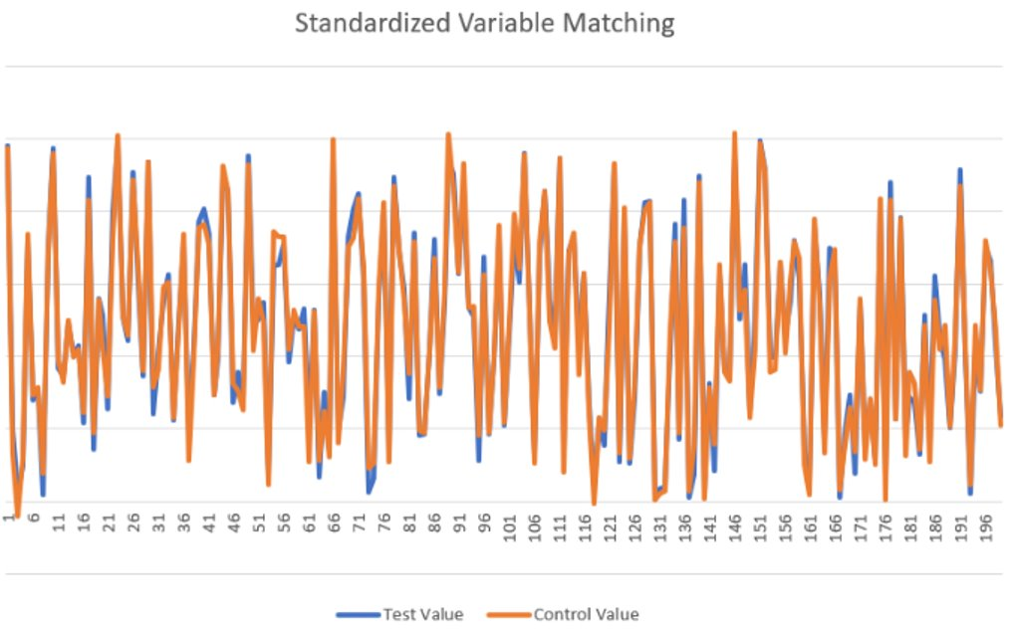
Matching Period: 04/01/2025 - 06/30/2025
Test vs Control
Similarity Match Results
Control group pre-processing matched on individual variables for this campaign.
Sample of variables matched:
Demo: Age, gender, income, geo.
ABCS Category Metrics:
Test and Control groups are matched on pre-period category sales.

Slide 12

“The right insights turn every touch point into a pure sales opportunity”
Thank you
Jerome Shimizu
(847)323-5365
jshimizu@abcsinsights.com
Michael Sheng
msheng@abcsinsights.com

